Slide 1
CubeFS
storage team of oppo

Slide 2
Background
CubeFS (formerly: ChubaoFS) was initially developed to provide storage solution for containerized applications in large scale container platforms.
Challenges
Large number of customers(volumes)
Storage usage hard to predict for a single user
Various file sizes ranging from KB to TB
Diverse read/write patterns, i.e. sequential or random
Data shared by upstream and downstream users
Key features
Multi-tenancy
Elasticity and scalability for metadata
Serve large amount of clients in a single cluster simultaneously
Optimized for both large and small files
Converge filesystem、S3-compatible interfaces and hdfs interfaces
Support erasure code
Multi layer storage

Slide 3
History
Presentation to CNCF
storage SIG
Released chubaofs-csi
Open sourced at github
March 2019
April 2019
June 2019
July 2019
Aug 2019
Nov 2019
Released v1.0.0
Sigmod'19 industrial paper
Released chubaofs-helm
Released v2.4.0 enhance stablity
OPPO join as key contributing company
(BEIKE, NetEase,MEIZU…）
Join CNCF sandbox
Oct 2021
Mar 2021
OCT 2020
Aug 2020
April 2020
Dec 2019
Support remote Shuffle
Support hdfs-compatible sdk
Released v2.0.0
support S3 interface
Fuse Client Online update
Jan 2022
Jan 2022
Jan 2022
April 2022
Released v2.5.0
support failure domain group
Released v3.0.0-beta
support erasure-code
repo renamed to cubefs
Next Release v3.0.0

Slide 4
Community Growth
Open sourced since March 2019
Sandbox project since Dec 2019
Statistics(https://chubaofs.devstats.cncf.io/):
before vs since joining sandbox
Commits: 516 -> 2351 (inc 355%)
Code committers: 17 (5 companies) -> 45 (11 companies) (inc 164%)
Pull requests: 56 -> 862 (inc 1439%)
Contributors: 27 (5 companies) -> 94 (11 companies) (inc 248%)
Contributions: 1112 -> 4068 (inc 265%)
Forkers: 110 -> 263 (inc 139%)
Watchers: 851 -> 1758 (inc 106%)

Slide 5
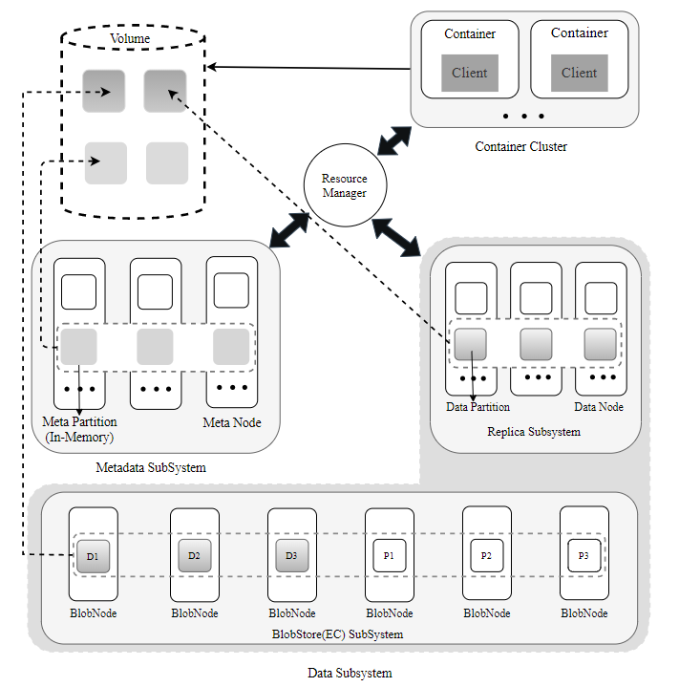
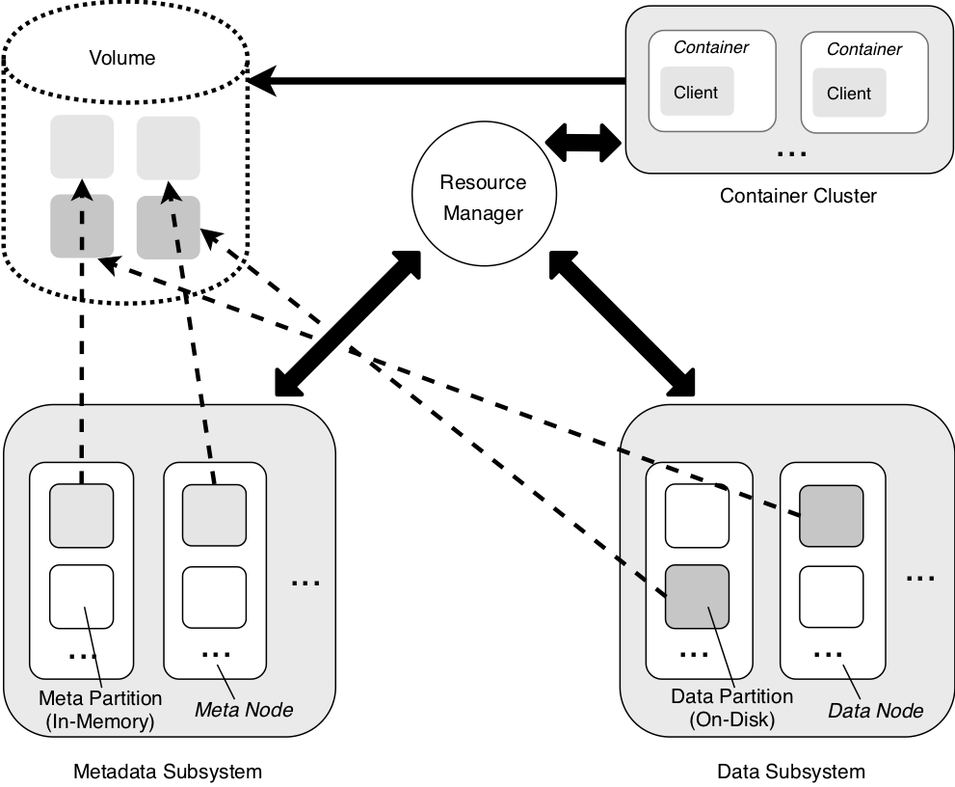
Architecture
release-2.x
release-3.x

Slide 6
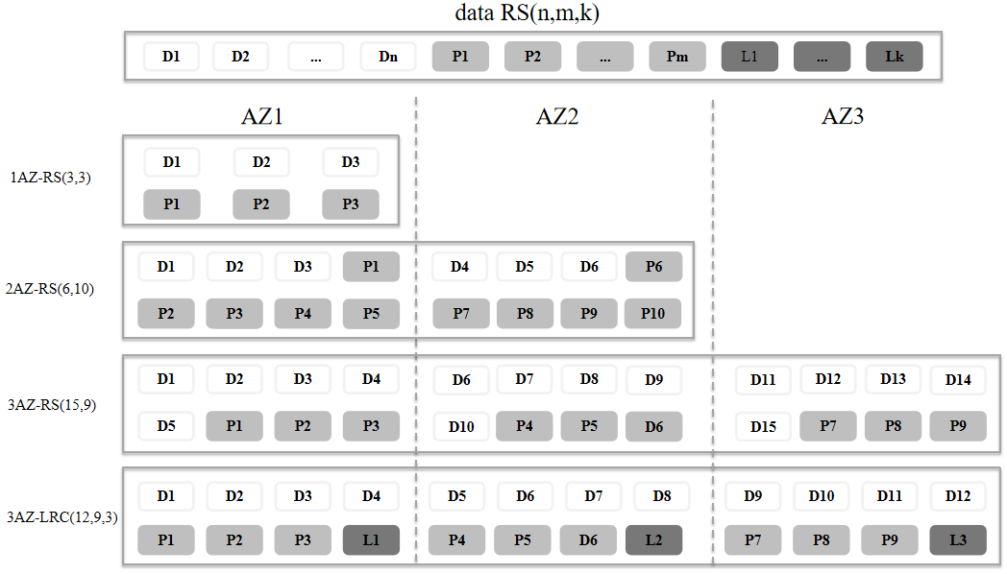
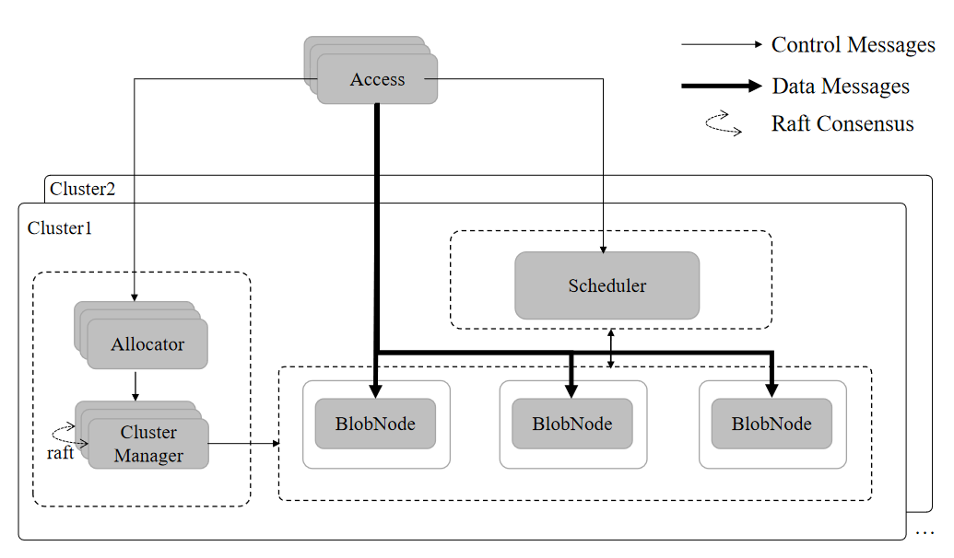
Erasure Code Subsystem
Main feature
Larger cluster capacity
Higher durability with 11 9s
Lower TCO：reduces redundancy from 3x to 1.33x or less
Multi-AZ deployments
Multi-specification configurable erasure coding mode

Slide 7
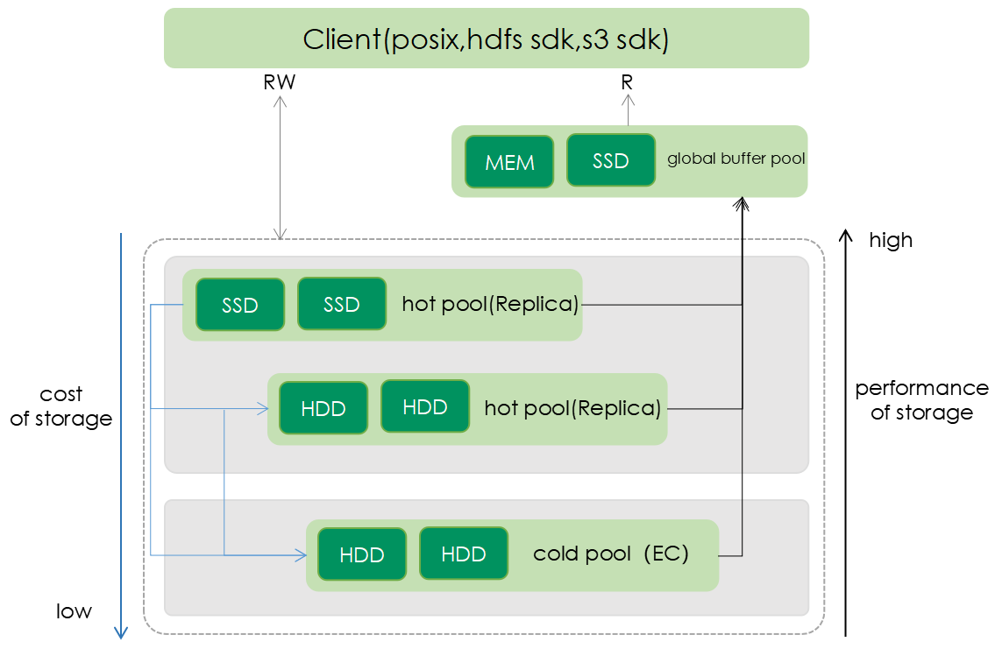
Multi layer storage
Main feature
support different storage resource pool
data migration automated
flexible configuration

Slide 8
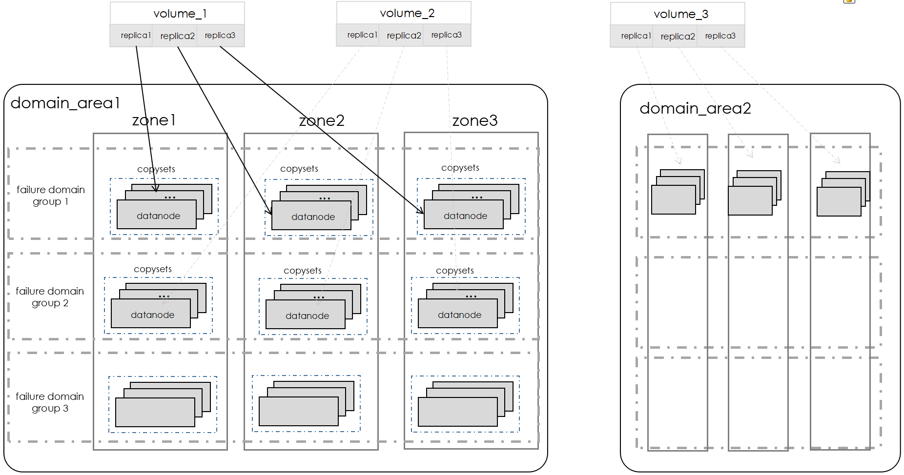
Durability
Enable failure domain on scenario of cross zone

Slide 9
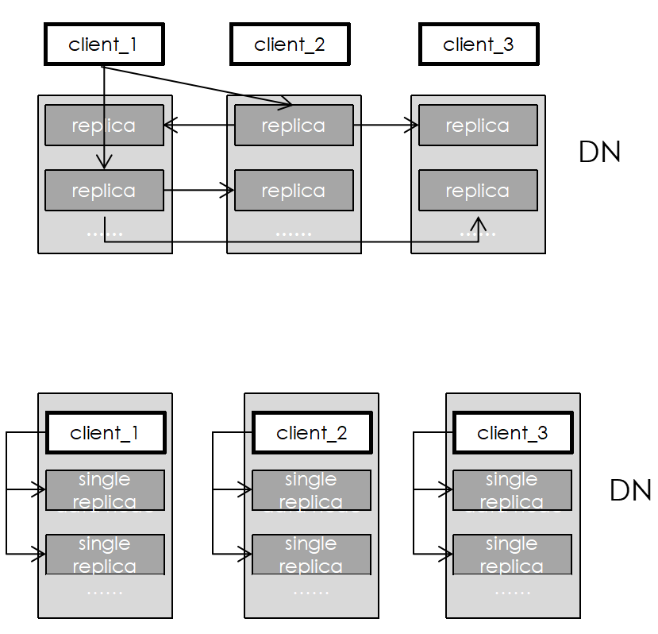
Flexible replication strategy
Replica Options
one to three replica
Single Replica Feature
reduce TCO
reduce network traffic
reduce write latency
Single Replica Scenario
service with low reliability requirements
hadoop remote shuffle
DataNode
three replica
DataNode
single replica

Slide 10
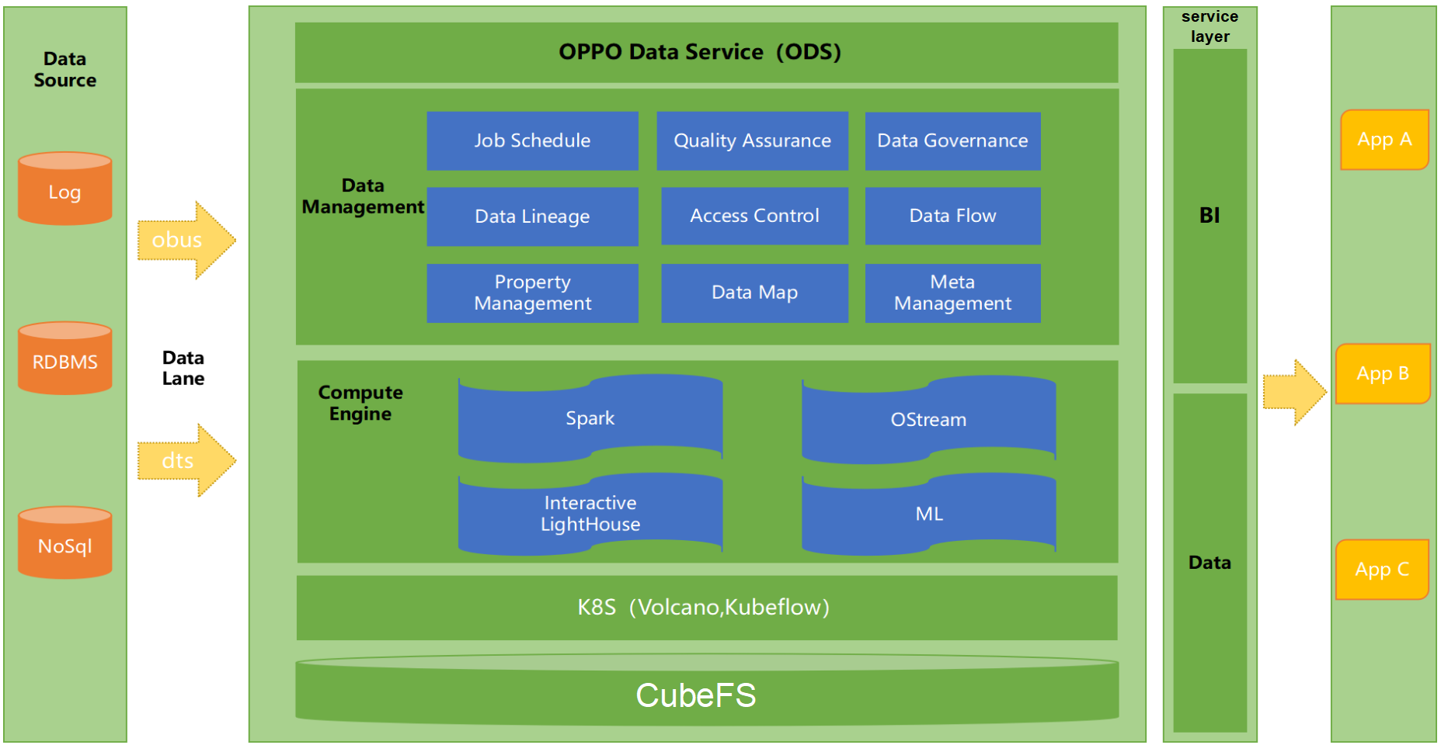
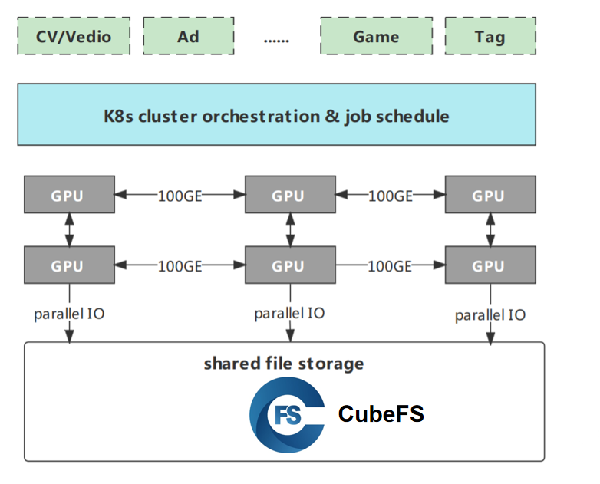
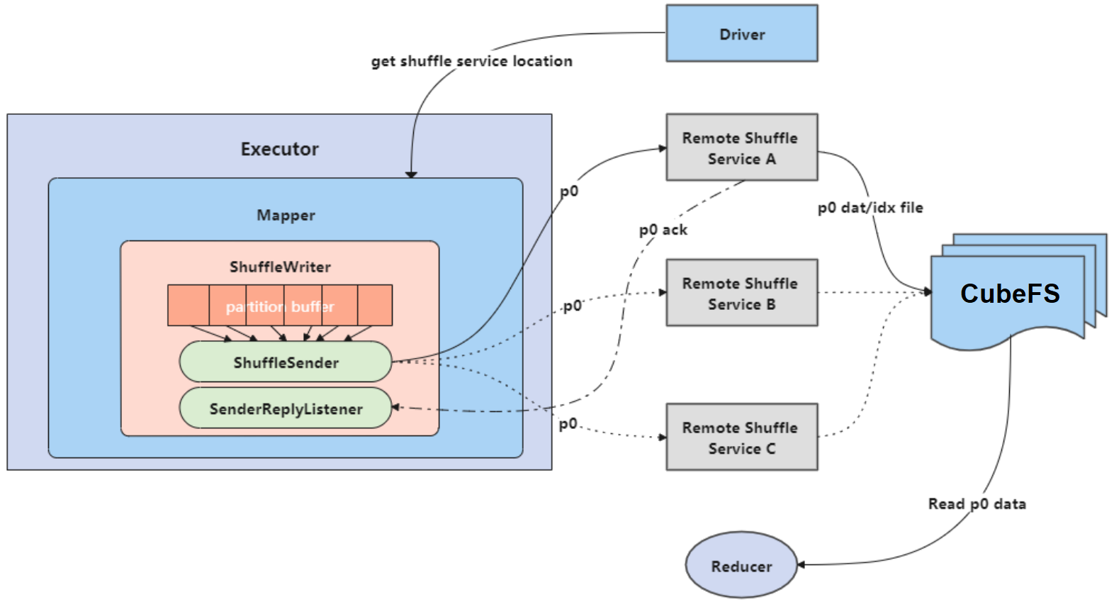
User Adoptions - OPPO
Data Lake
OPPO : A consumer electronics and mobile communications company.
AI Platform
Spark Remote Shuffle Service

Slide 11
Thanks!

